Slide 1

Breaking Into Research: AI/ML Foundations, Careers, and Publications
Atharva College of engineering

Slide 2

About Myself
Research Assistant at NUS, NTU, Georgia Tech, UCSB, KCL, IIT Patna, Mandi, Dhanbad, Jodhpur, DRDO, NIDM
Researcher in Natural Language Processing and AI
Working on projects related to reasoning and interpretability of LLMs
13+ Research Papers in Q1 Journals and A* Conferences
~1.9 years of Research Experience
7x Professional Speaker now 8x :)
Final Year Student at DJ Sanghvi College of Engineering

Slide 3
1. Fundamentals of Artificial Intelligence

Slide 4
Lets just say you want to bunk a lecture You need to give some sort of excuse

Slide 5
Emergency
I am hungry
Feeling Unwell
Need to study for Term Test
Train Miss ho jayegi ☹
Family Function or Event you need to attend
Decision to Bunk the lecture
Yes/No
Threshold >= 2

Slide 6
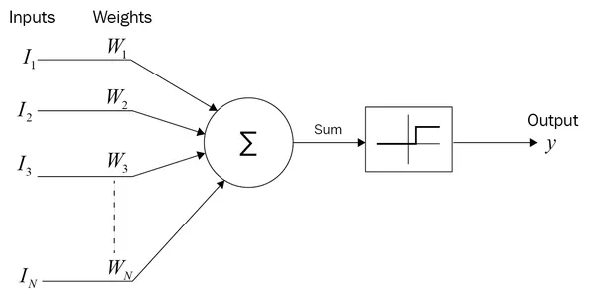
Basics of AI – McCulloch Pitts Neuron
Threshold Function >= 2
Summation = I1 * W1 + I2 * W2 + I3 * W3

Slide 7
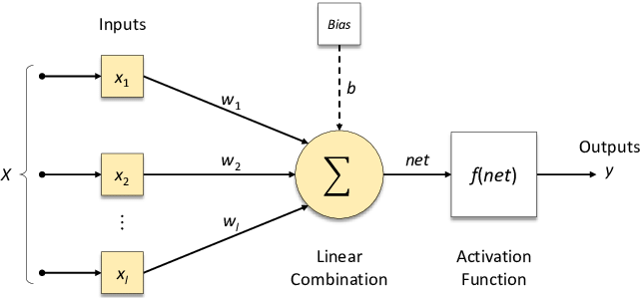
Basics of AI – Perceptron

Slide 8
Difference
Mc Culloch Pitts Neuron
Perceptron
Weak and Logic Only
Input are binary
Inputs are not weighted
First neuron model
There can be some sort of learning involved
Inputs can be real valued
Inputs are weighted
First learning model

Slide 9
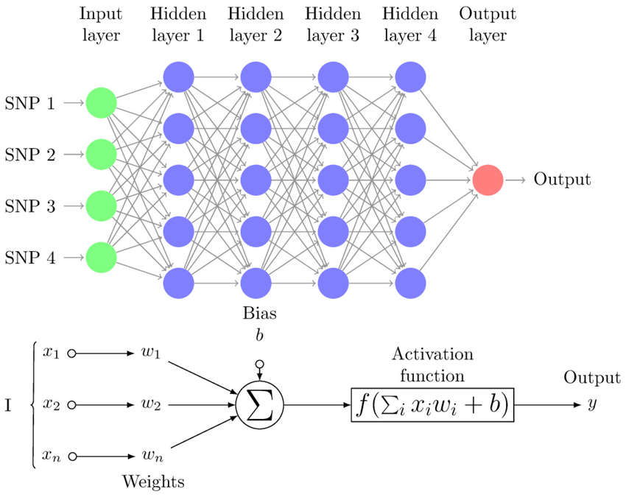
Multi Layer Perceptron
Test Cricket Example

Slide 10
Computer understands which Language?

Slide 11
Lets Play a game!! Antonyms : King = Man =

Slide 12
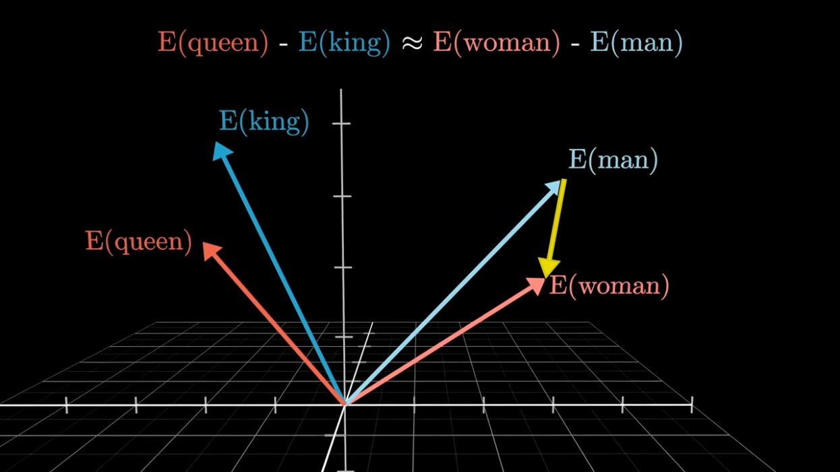

Slide 13
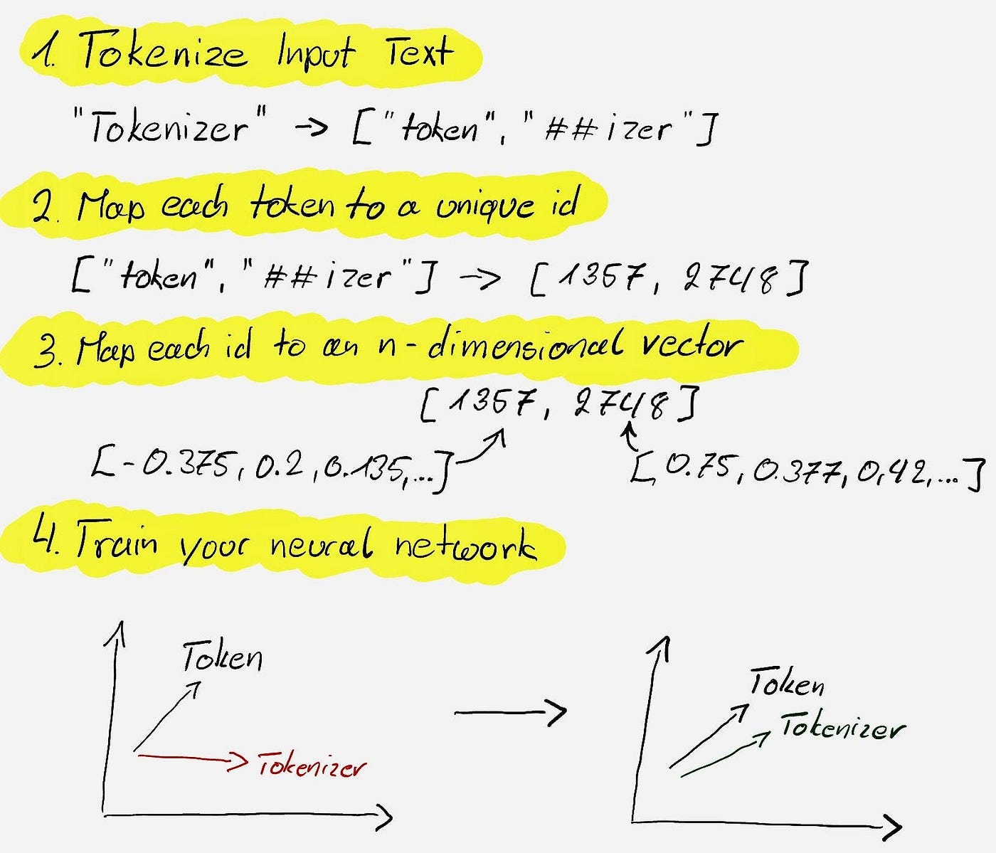
https://platform.openai.com/tokenizer

Slide 14
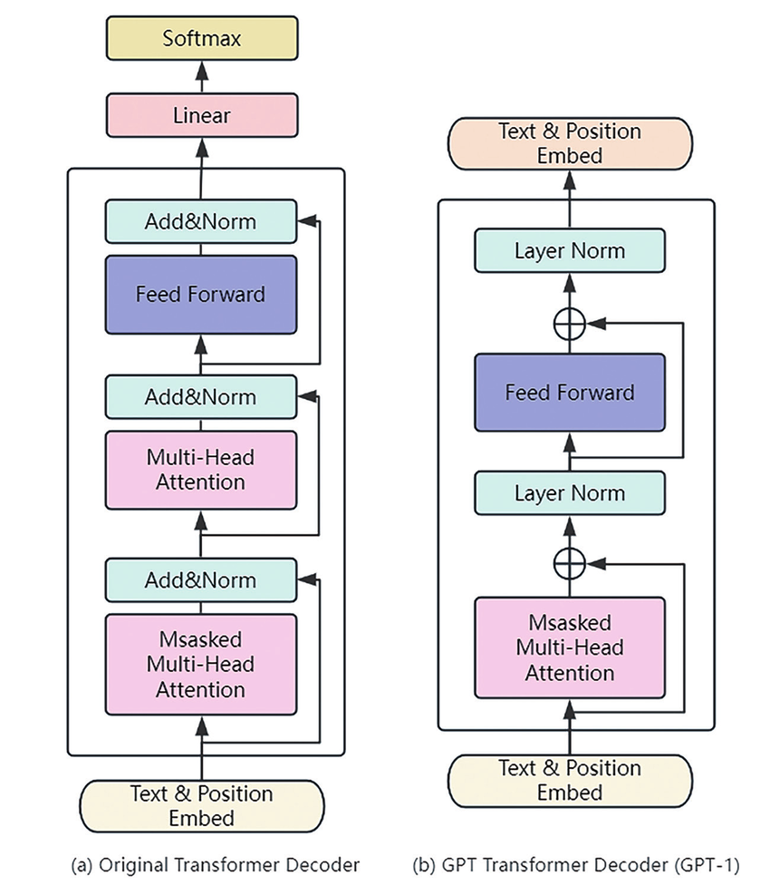
Attention
Feed Forward Neural Network
Add Normalization
Linear
Softmax

Slide 15
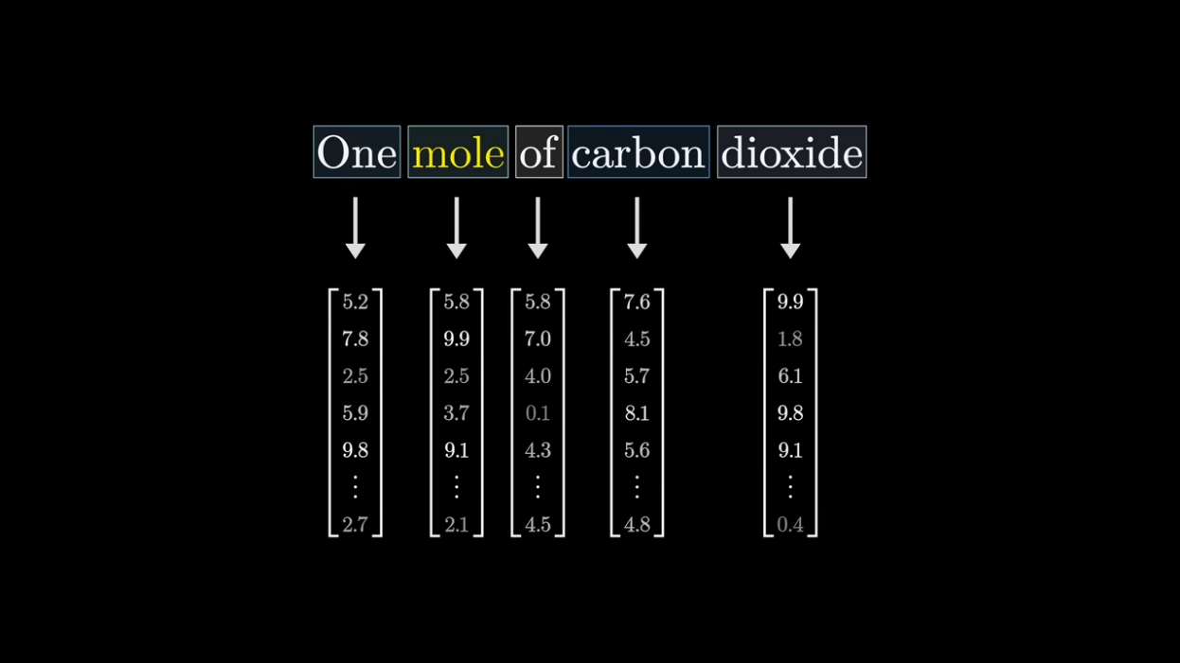
Input

Slide 16
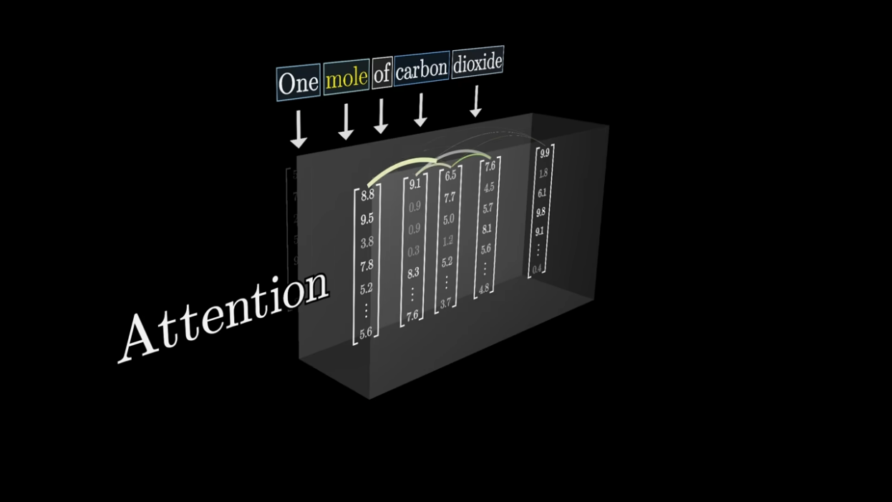
Attention

Slide 17
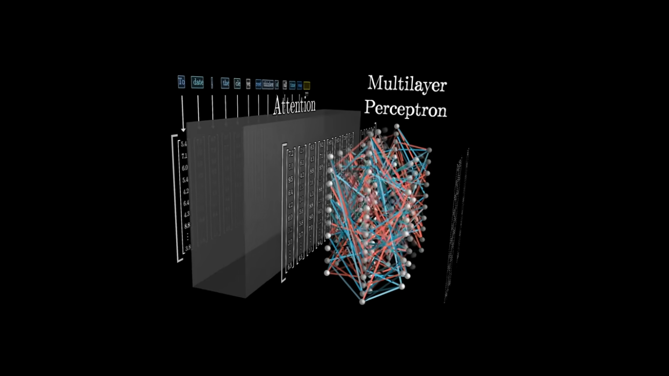
Multilayer Perceptron

Slide 18
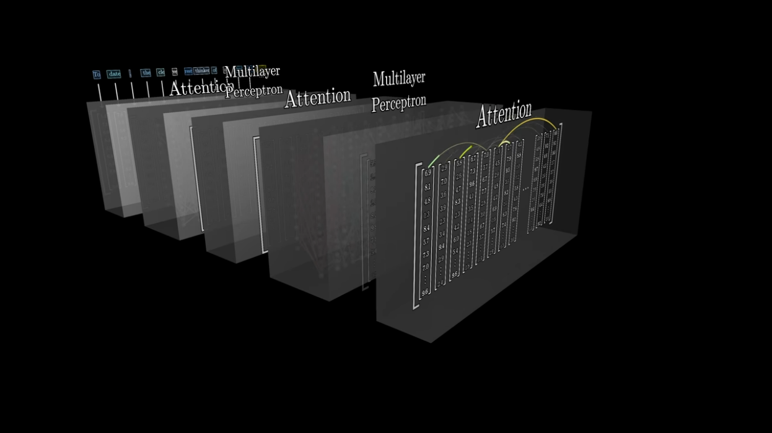
Multiple Rounds

Slide 19
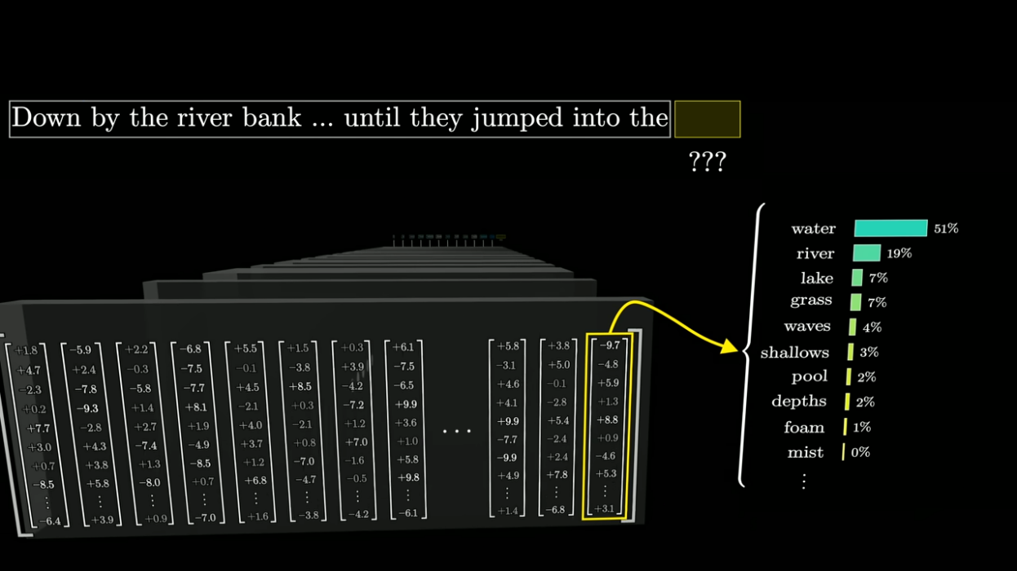
Output

Slide 20
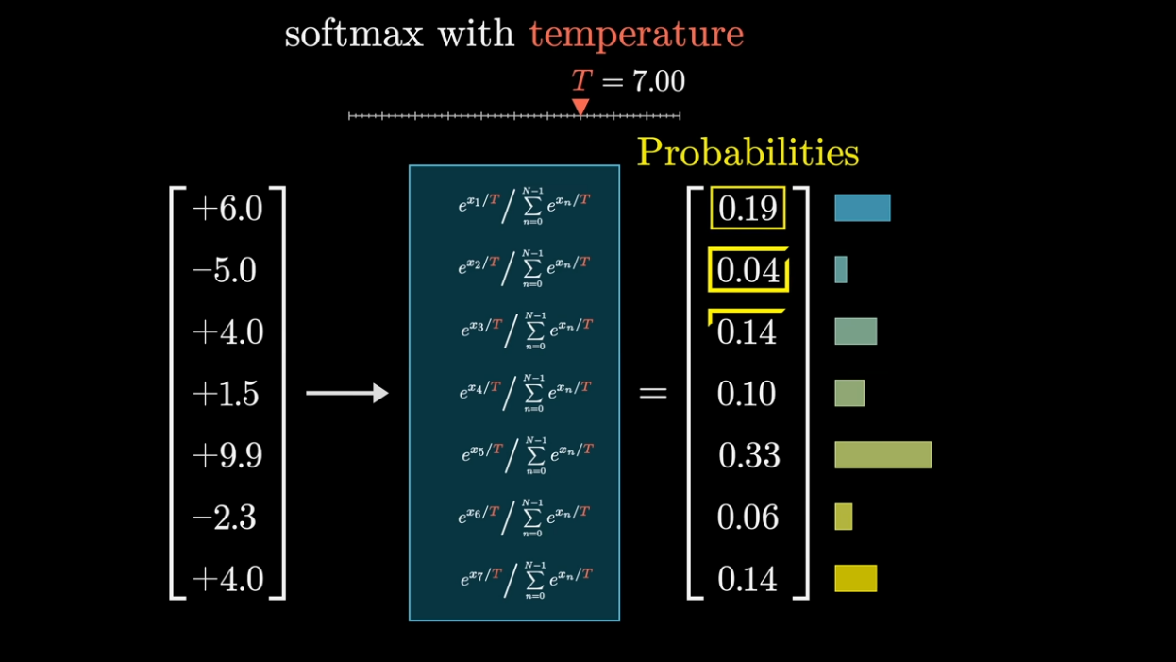
Softmax and
Temperature

Slide 21
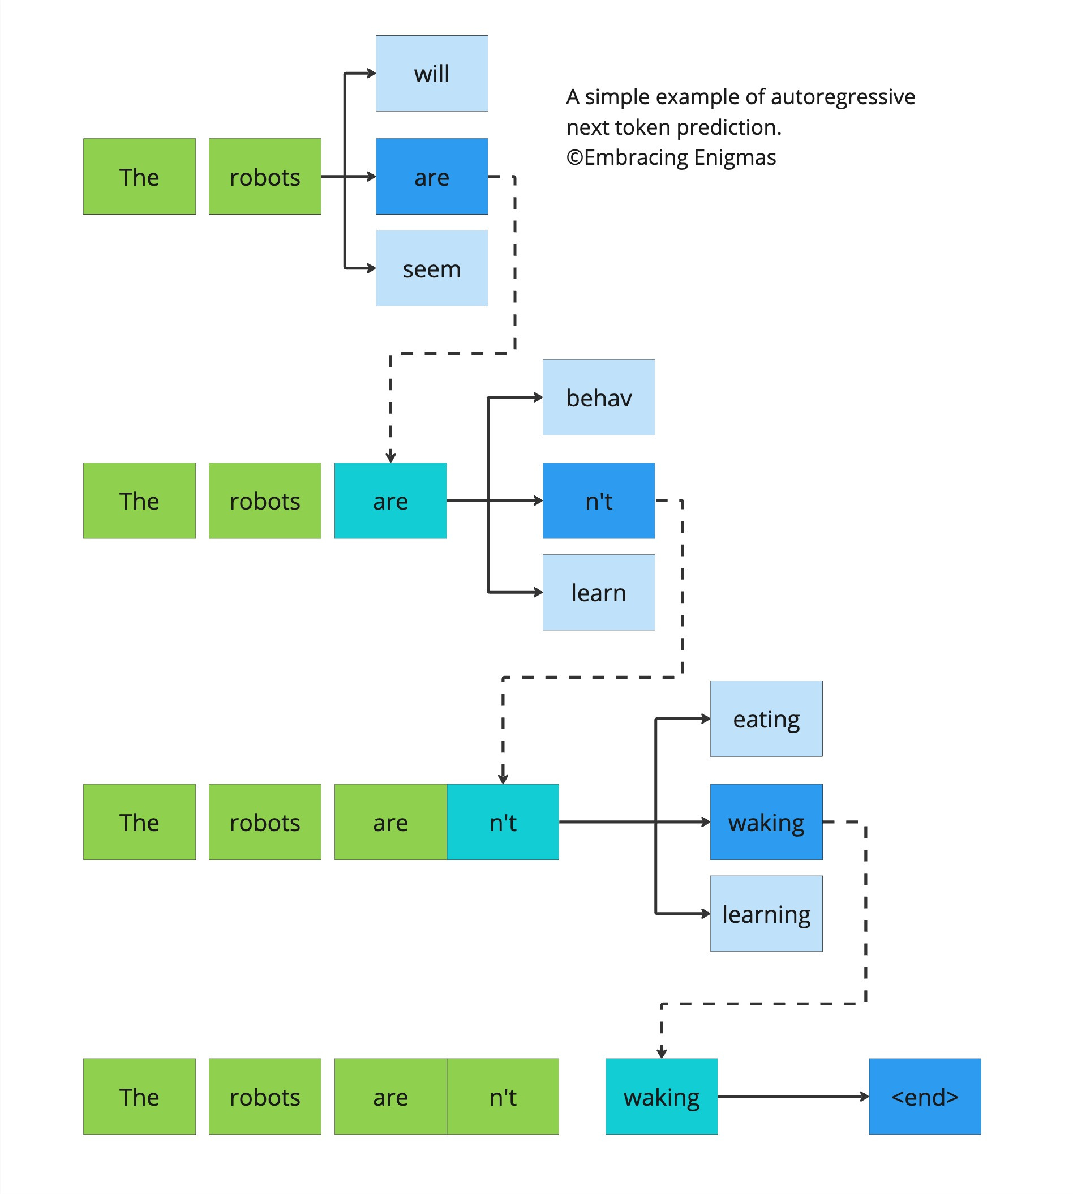
Next Token Predictions

Slide 22
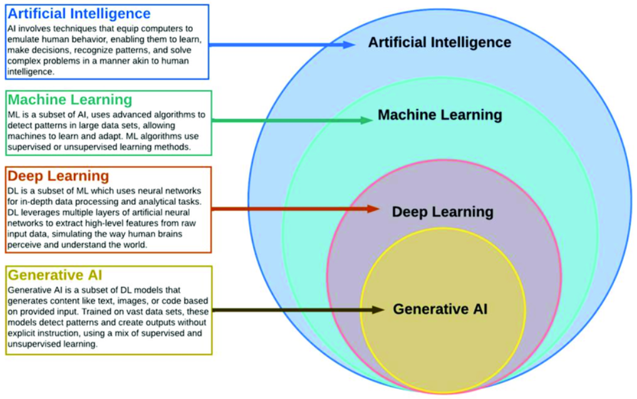
Generative AI
Text
Voice
Images
Videos
Data and Code

Slide 23
2. Applications of Artificial Intelligence (LangChain)

Slide 24

LangChain
A Python framework to build applications powered by LLMs
Manage prompts, memory, chains, tools, and agents
Ideal for chatbots, document Q&A, agents, and more
Abstracts complexity of calling LLMs repeatedly
Easy chaining of tasks and reasoning steps
Built-in support for structured outputs (e.g., Pydantic, JSON)

Slide 25
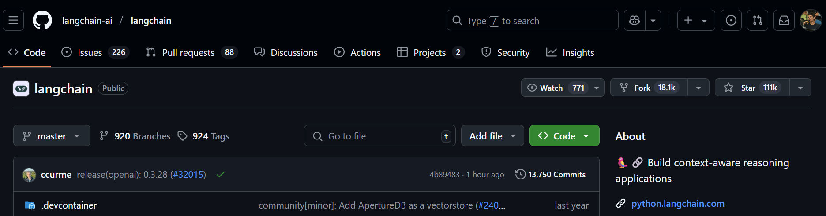
Why LangChain?
pip install langchain
npm install langchain
Popular Alternatives : LlamaIndex, Haystack

Slide 26
3. Breaking into Research

Slide 27



Scenario
Why?
You have no research papers. I want students who will learn and help me in my research
I am DJSCE Passout with with 10 CGPA and 10 Hackathon wins
You are not worthy for our university
What are your qualifications?
UNIVERSITY
PROFESSOR
DJSCE STUDENT
DREAM UNIVERSITY

Slide 28
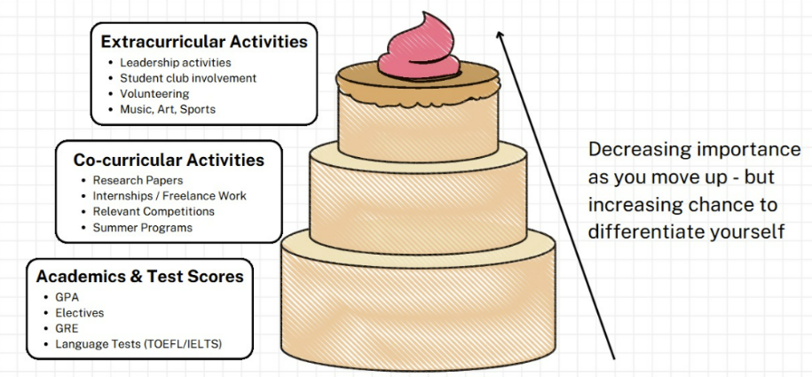
HARSH REALITY TO SUCCEED

Slide 29
Research Paper
A research paper is a type of academic writing that provides an in-depth analysis, evaluation, or interpretation of a single topic, based on empirical evidence.
Research papers are similar to analytical essays, except that research papers emphasize the use of statistical data and preexisting research, along with a strict code for citations.
Research papers are a bedrock of modern science and the most effective way to share information across a wide network.
Researchers state their findings plainly and with corresponding evidence so that other researchers can consequently use the paper in their own research.

Slide 30
Types of Research Papers
Interpretative Papers: Use theoretical frameworks and data to explore and support a specific thesis or research topic.
Review Papers : Provide a comprehensive overview and analysis of existing research on a specific topic.
Case Study Papers: Focus on an in-depth investigation of a single or few cases to explore a specific issue.
Comparative Research Papers: Compare and contrast multiple entities or cases to identify trends or relationships.
Survey Research Papers: Present findings based on data collected from surveys conducted on a given topic.

Slide 31
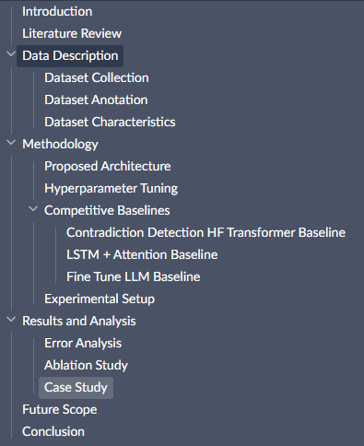
SECTIONS OF A RESEARCH PAPER
TITLE***
ABSTRACT***
INTRODUCTION**
LITERATURE REVIEW*
DATASET DESCRIPTION / SURVEY*
METHODOLOGY***
PROPOSED ARCHITECTURE***
RESULTS**
FUTURE SCOPE*
CONCLUSION***
REFERENCES**

Slide 32
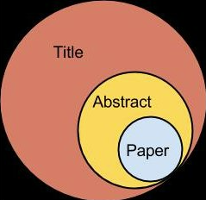
Title and abstract
CRISP CLEAR AND TO THE POINT TITLE UNDER 15 WORDS
A CONCISE SUMMARY OF A RESEARCH PAPER THAT DESCRIBES ITS FOCUS AND KEY FINDINGS
PLS DON’T FAKE IN TITLE OR ABSTRACT

Slide 33

Introduction and literature review
Make a good flow by introducing the domain and topic of the research paper with concrete citations as proof to your claims.
Add as many citations in this sections.
Literature Review is the summary or insights of the top 5 relevant and insightful research papers related to your research paper.

Slide 34
BLACKBOX TESTING - METHODOLOGY
Conduct a blackbox test in order to actually formulate the methodology on how you will tackle and solve the thesis statement you created earlier.
BLACKBOX
SOME INPUT
SOME OUTPUT

Slide 35

RESULTS FUTURE SCOPE AND CONCLUSION
Put in the actual results from your methodology and proposed architecture.
Without results the reviewers will not be convinced to accept you research work.
Bluntly state the area of improvements and advancements others can do on top of your research work.
Conclude your research paper with positive thoughts and clear summarization.

Slide 36
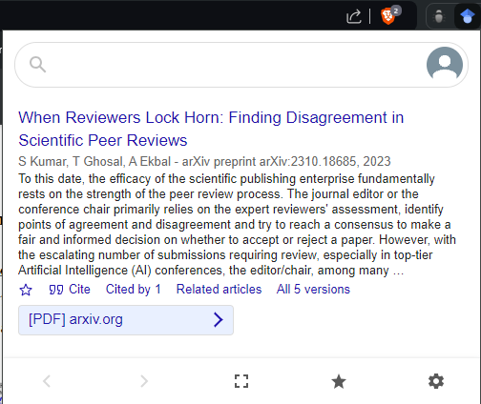
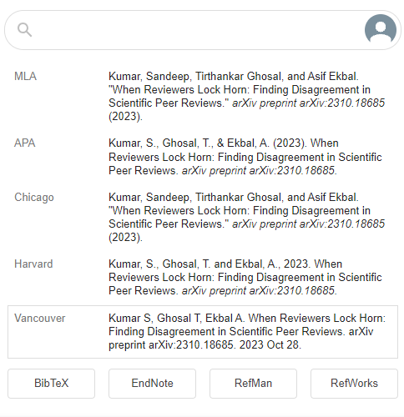
REFERNCES
Appreciate the world If you have looked up to someone else’s research work for your thesis add their research work in the references section.
The Google Scholar Button Chrome extension can greatly simplify your life.

Slide 37
CONFERENCES VS JOURNALS
CONFERENCES
JOURNALS
Peer Review is done by college faculties or by non domain experts.
Conferences are not bound to a specific topic but are bounded to a domain.
Impact Factor is low.
More focus is on Presentation of your idea.
Research Paper of fewer pages are also accepted.
Peer Review is done by skilled domain experts.
Journals are bounded to a specific domain.
Impact factor is high.
More focus is on actually using and citing your research.
Need Detailed Research of the thesis proposed.

Slide 38

Connect me on
mihirpanchal.tech
Portfolio

